Slide 1
2019 - 2020 RETIREES

Slide 2
HONORING 2019-2020 RETIREES
UNIVERSITY OF WEST GEORGIA
ASSOCIATION OF RETIRED FACULTY AND STAFF
AUGUST 22, 2020

Slide 3
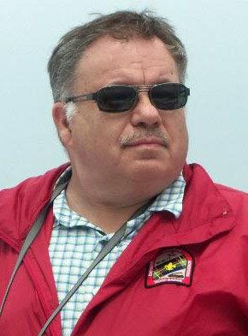
JERRY ALLEN
Manager of System Administration and Data Center UWG Information Technology Services
2015-2019
14 years of related experience at Georgia State University
Plans for retirement: experiencing the adventure of visiting every national park in the United States; completing the Coweta County Extension Service Master Gardener course as of 4/1/19

Slide 4
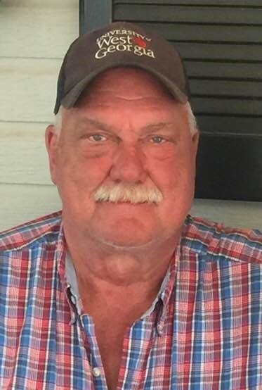
BILLY R. BEARDEN
HV Mechanic-Intermediate in Campus Planning and Facilities (Maintenance)
2001-2020
Plans for retirement: continuing to recover from surgery he had shortly after retiring; getting around on a knee scooter and golf cart, but looking forward to fishing and more gardening in the future

Slide 5
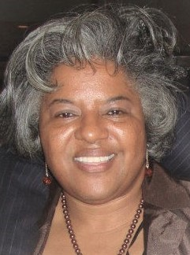
CAROLYN BERRY
Administrative Assistant (and other roles) in College of Education
2000-2019
Plans for Retirement: traveling, including travel across the United States by train; visiting family, including spending time with grandchildren; reading; staying active in the community

Slide 6
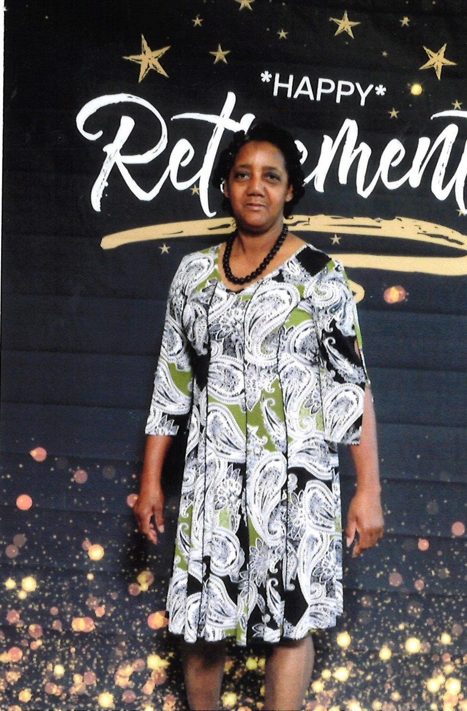
PEGGY BOSTON
Custodian-Associate in Campus Planning and Facilities (Custodial Services)
1992-2019
Plans for retirement: looking after grandchildren and providing transportation for people who can't drive or have no means of transportation on their own

Slide 7
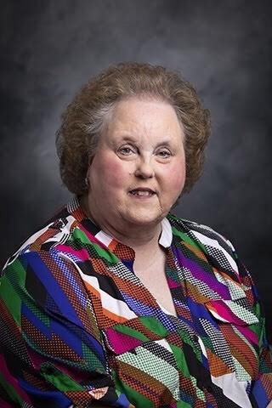
JUDY DAVIS BUTLER
Professor in Secondary Education (College of Education)
1996-2020
Plans for retirement: traveling around the world, including writing a blog Judy’s Sojourns, continuing to work on accreditation visits; working with church and community

Slide 8
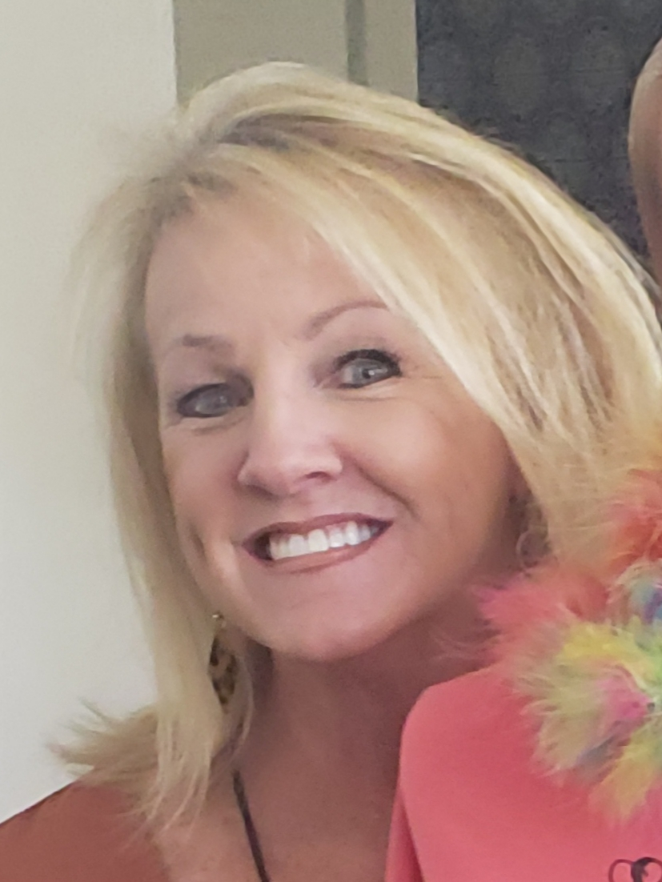
WANDA WALKER CALHOUN
Instructor in Early Childhood Education (College of Education)
Director of Office of Field Experiences (College of Education)
2009-2019
Plans for retirement: enjoying family, traveling, and gardening

Slide 9
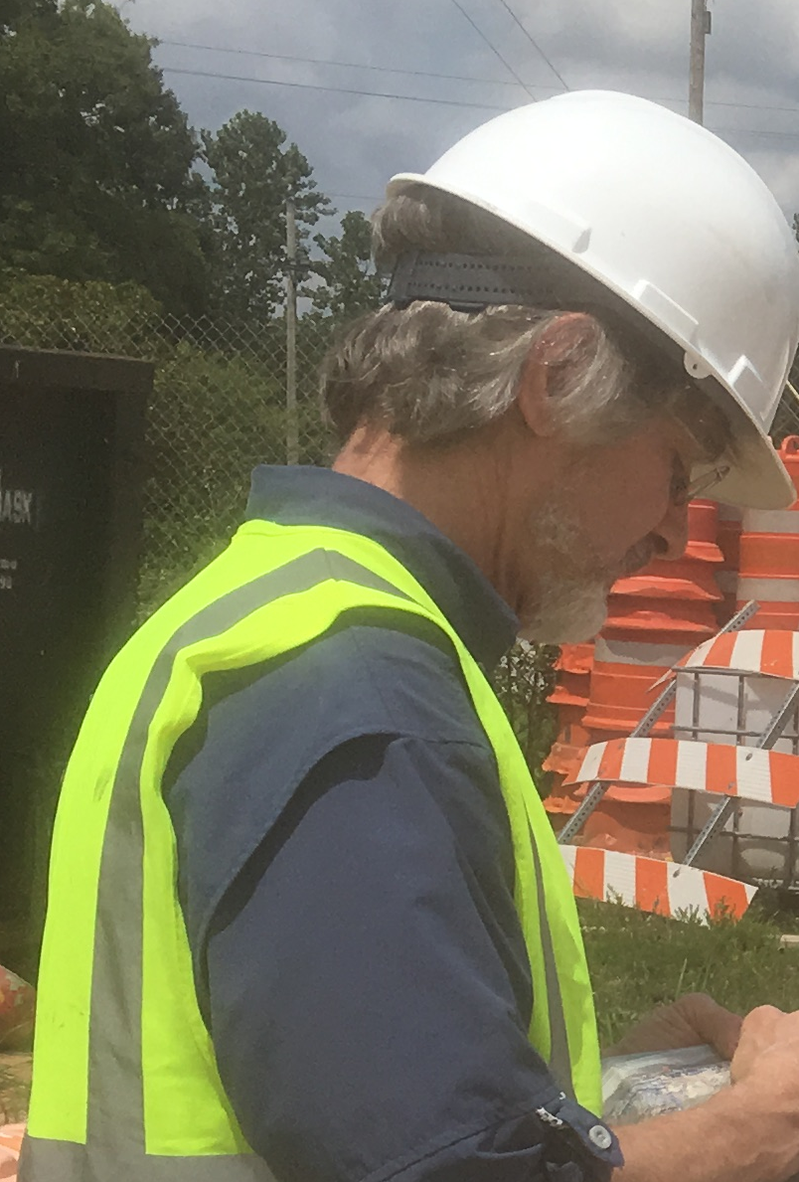
JOHN CONGLETON
Senior Lab Coordinator in Geosciences Department (College of Science and Mathematics)
1998-2019
Plans for retirement: working with the environmental consulting firm he established and looking forward to traveling up and down the East Coast

Slide 10
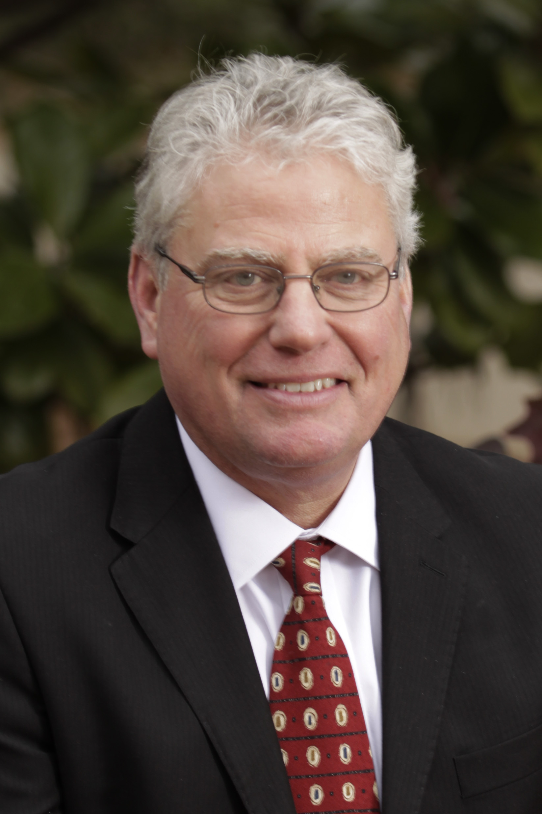
MICHEAL CRAFTON
Professor in English (College of Arts and Humanities)
University of West Georgia Provost
University of West Georgia Interim President
1982-2020
Plans for retirement: enjoying the art world, learning languages, remaining active professionally in teaching and other activities, and traveling

Slide 11
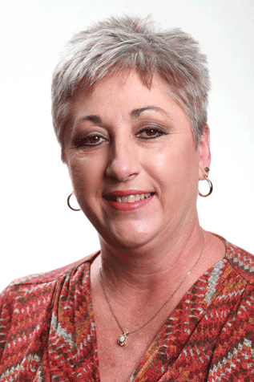
TAMMY B. CREWS
Senior Customer Service Representative in Information Technology Services
1982-2020
Plans for retirement: looking forward to traveling, with beach trips a favorite, and also attending concerts

Slide 12
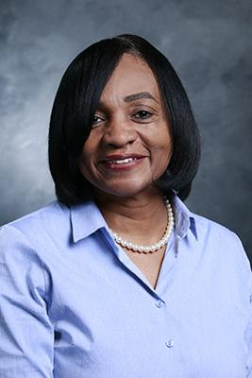
NANCY DUBOSE-WATKINS
Senior Administrative Support (Center for Diversity and Inclusion)
2009-2020
Plans for retirement: looking forward to enjoying her first grandchild, who with the family is moving to Carrollton, and having the chance for more extensive traveling, especially to Italy

Slide 13
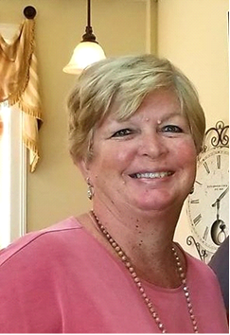
DALE K. DUFFEY
Administrative Assistant (Continuing Education)
Office Manager in the Alumni House
Gift Entry Accountant, UWG Foundation
1994-2020
Plans for retirement: gardening, beach trips, keeping up with grandchildren, getting together with coworkers

Slide 14
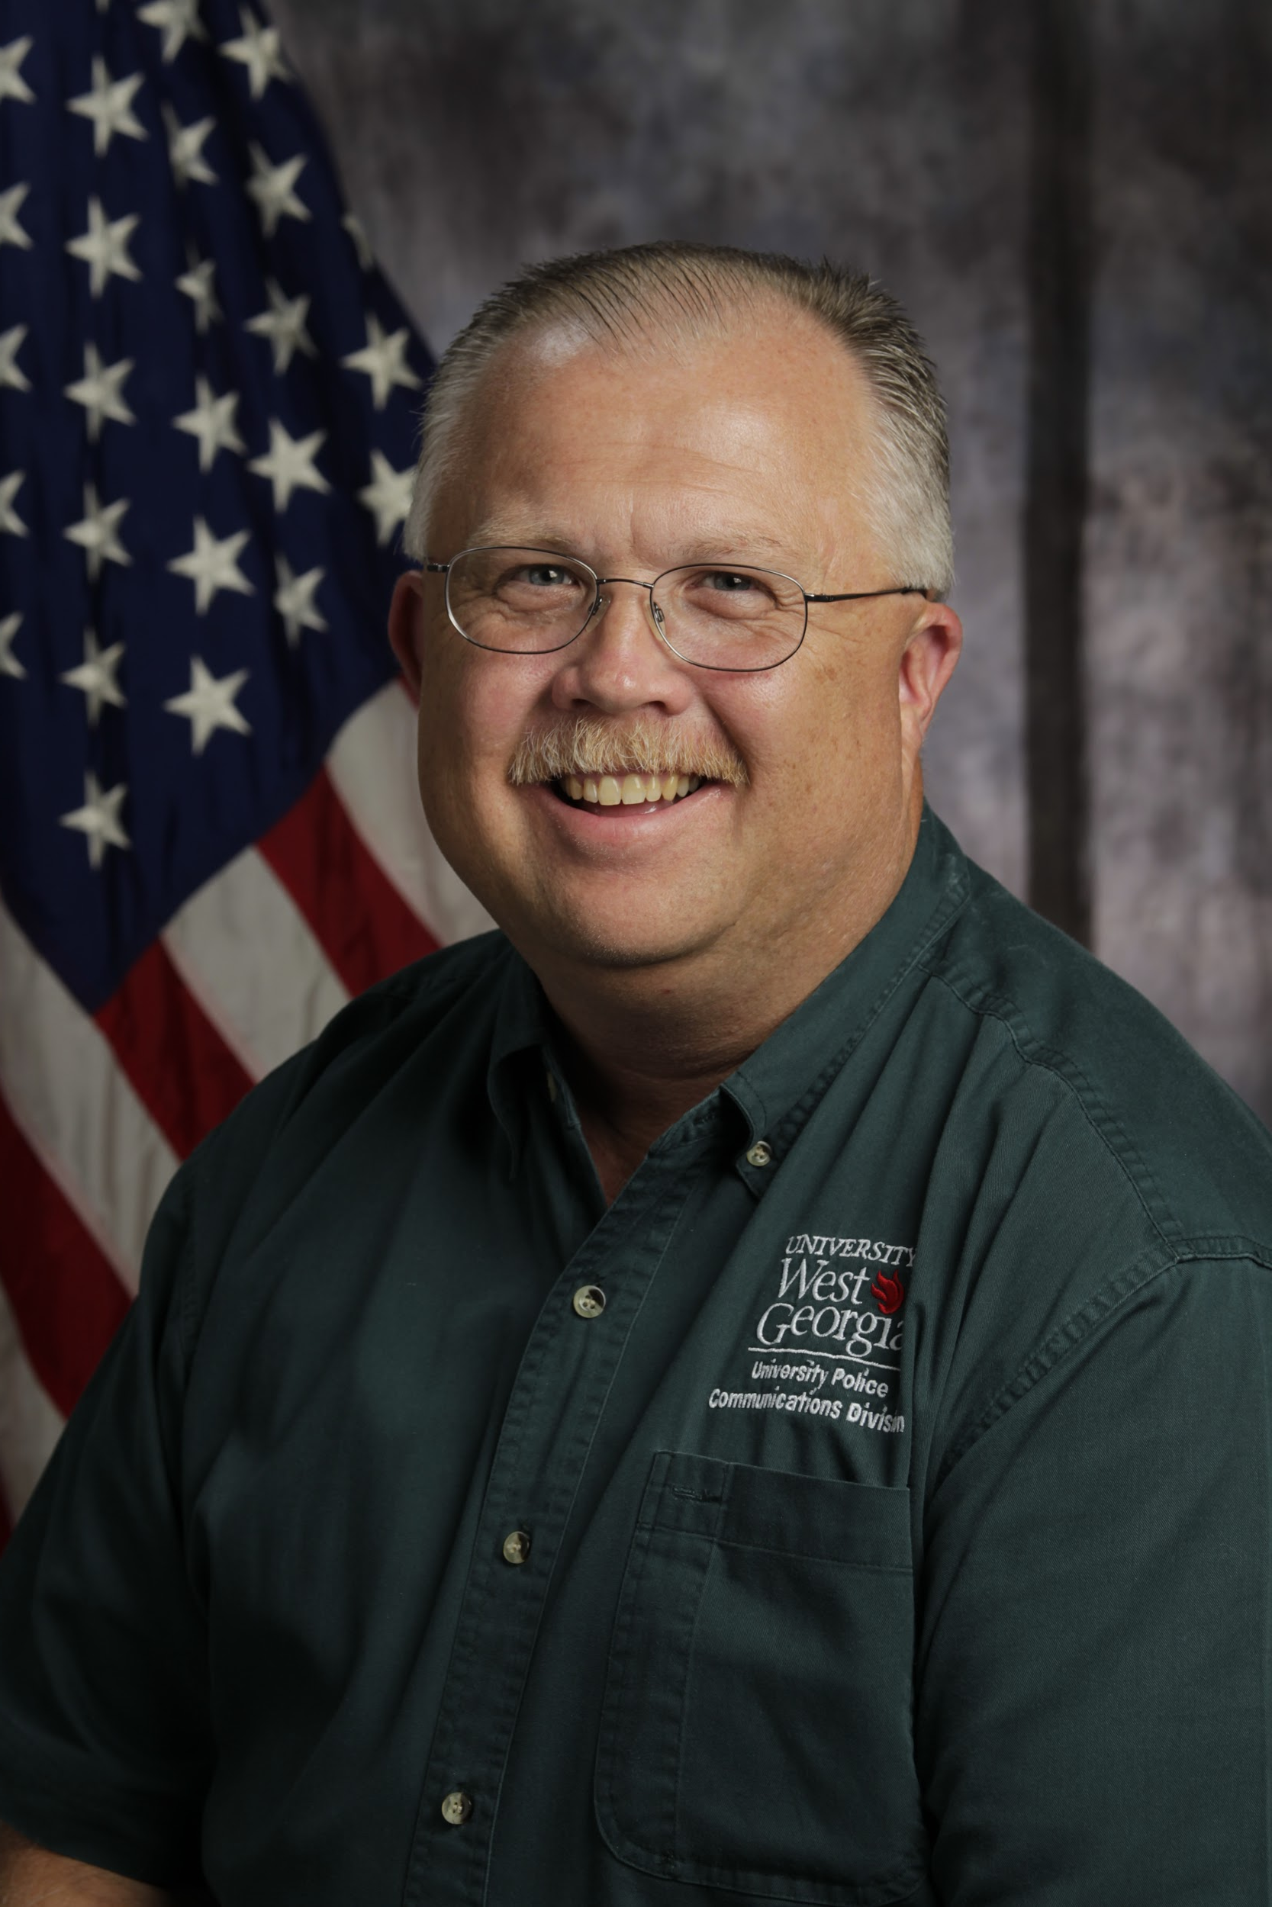
DOYLE FOLDS
Communications Officer (University Police)
1989-2020
Plans for retirement: looking forward to a new grandchild coming in September and traveling when conditions permit

Slide 15
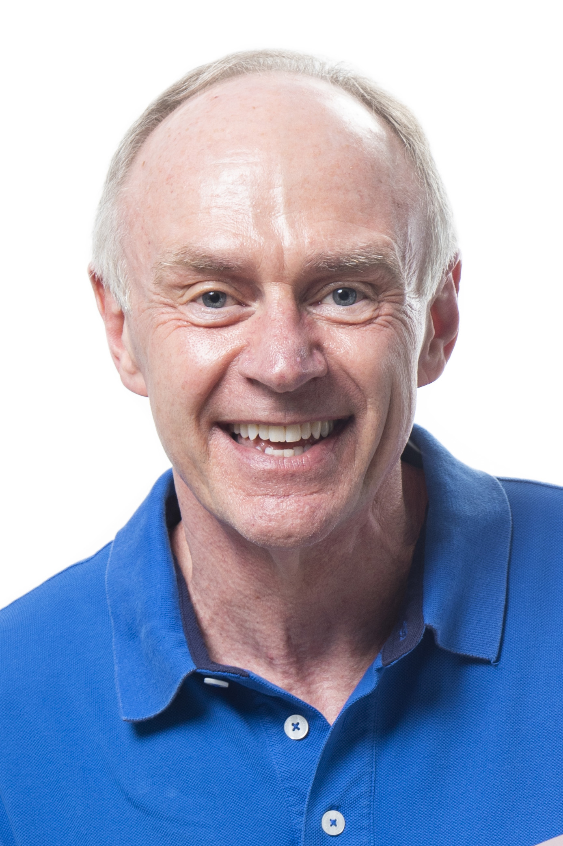
CHRIS GEIGER
Director of the Center for Student Involvement (Student Services)
1986-2019
Plans for retirement: anticipating travel to New York, as well as Wisconsin to visit family; enjoying gardening and reading

Slide 16
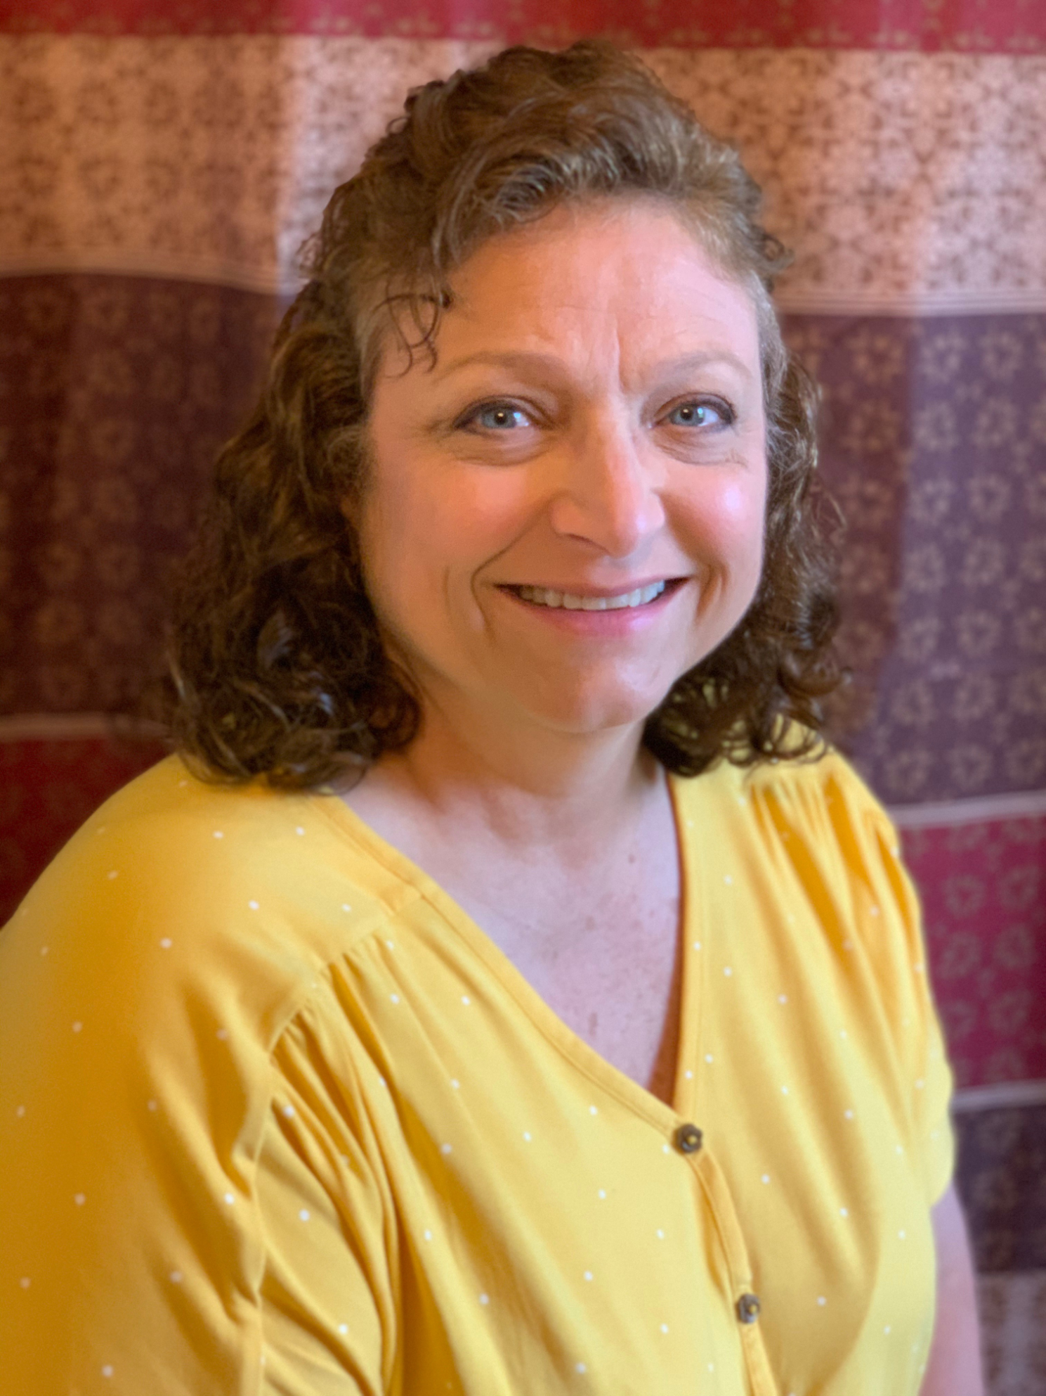
KAREN GIBBS
Cashier in Bursar's Office (Business & Finance)
Work Information Center Specialist in Campus Planning and Facilities
2005-2020
Plans for retirement: traveling with her husband to "see America"

Slide 17
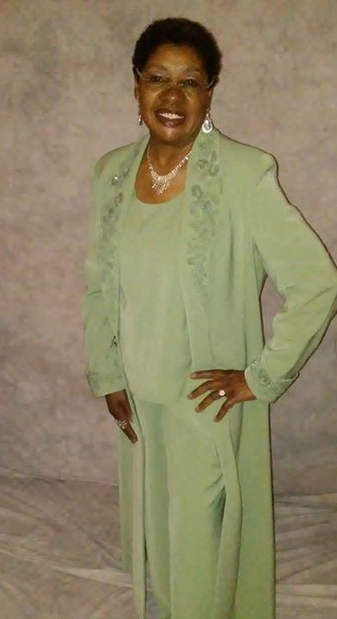
LINDA A. HENSON
Custodian-Associate in Campus Planning and Facilities (Custodial Services)
2007-2019
Plans for retirement: enjoying life and taking care of patients at a nursing home where she works part-time

Slide 18
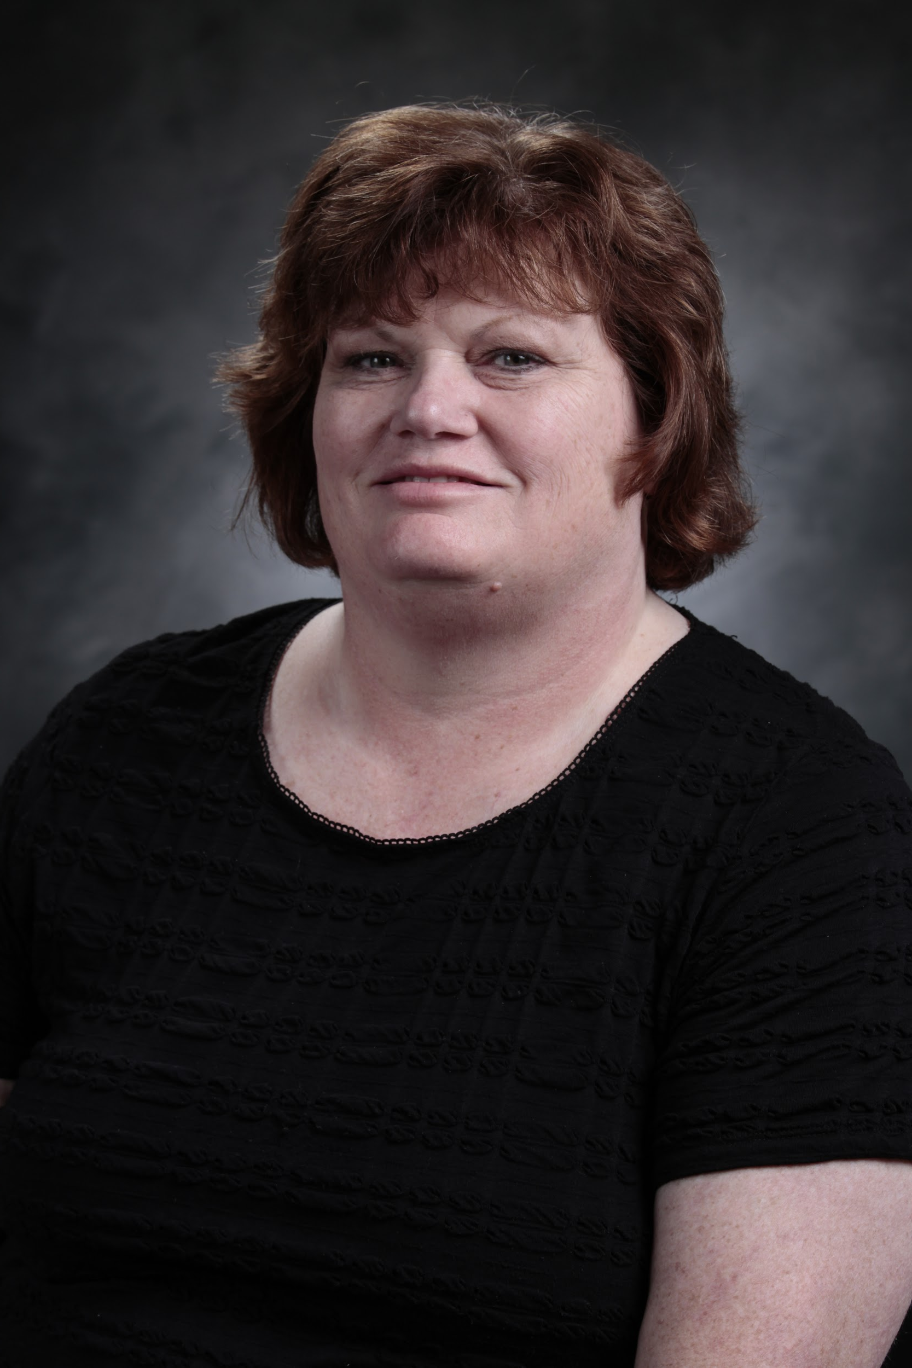
KIM INGRAM
Cashier (Bursar's Office)
2003-2019
Plans for retirement: looking forward to traveling not only to Texas, but also returning for another Alaska trip and getting to Greece

Slide 19
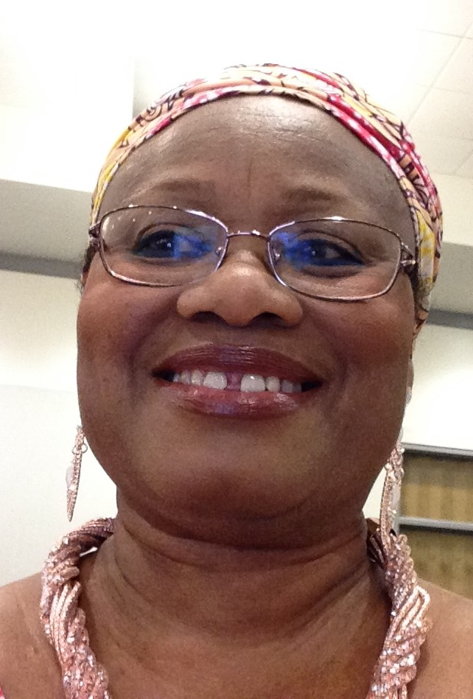
DORIS RAILEY KIEH
Program Coordinator (Center for Diversity and Inclusion)
2009-2019
Plans for retirement: working in her church library for now and planning to go back to work once the pandemic is contained

Slide 20
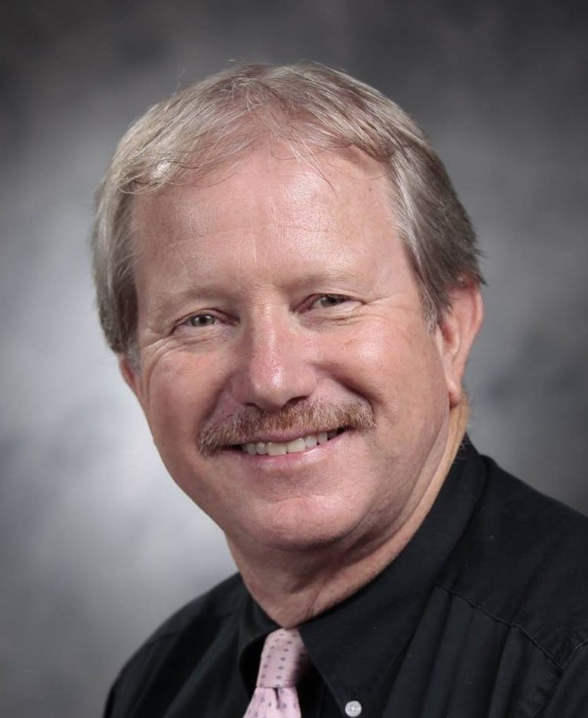
DAN LEWIS
Coordinator of Business and Finance Development
Executive Director of the Center for Business Excellence (Business and Finance)
2004-2020
Plans for retirement: continuing to exercise, play golf, travel to visit his children, participate in goodwill community endeavors, and enjoy the beach

Slide 21
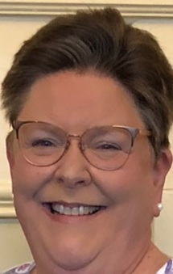
LAURA WHITE MAYFIELD
Textbook Manager (University Bookstore)
Records Coordinator and Departmental Assistant (Human Resources)
1992-2020
Plans for retirement: spending more time with family and friends; spending time at her home in Laguna Beach, Florida; and enjoying her two corgis

Slide 22
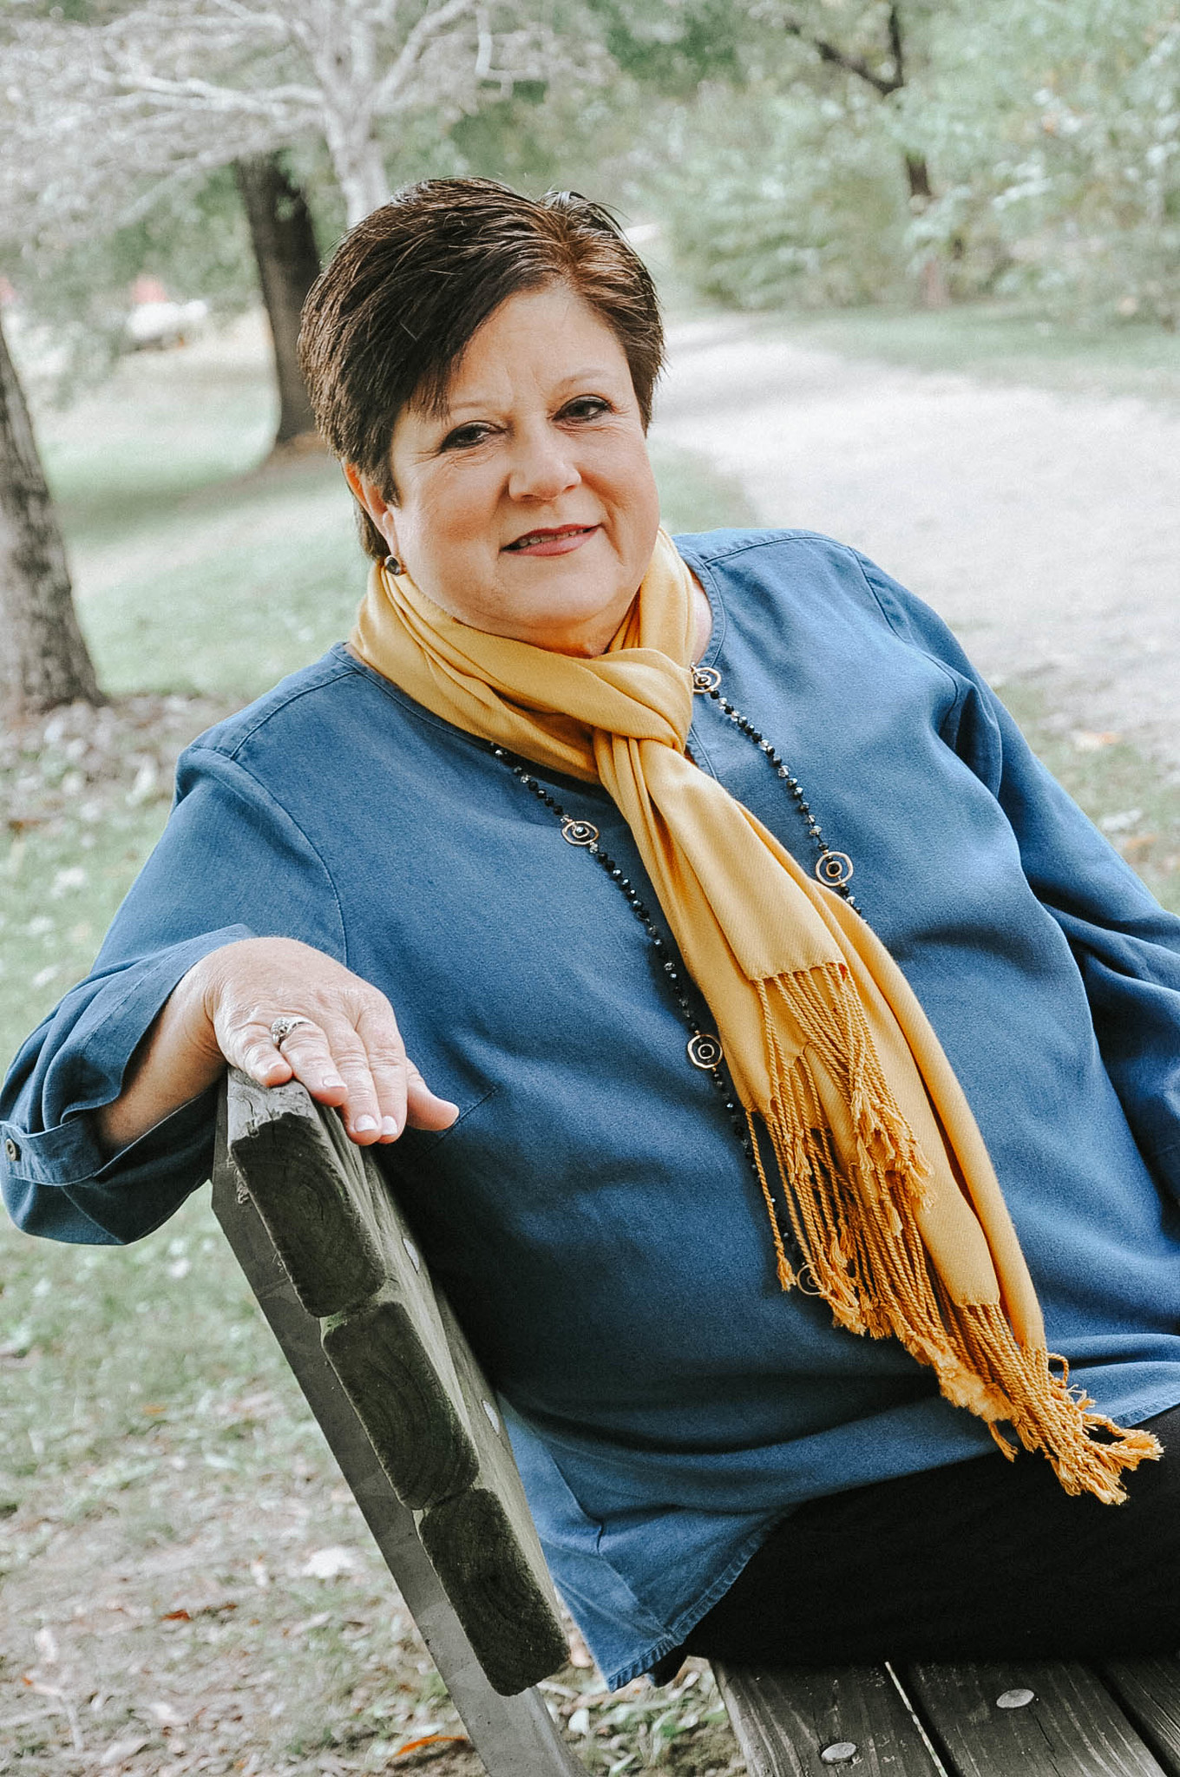
PAT MURPHY
Head Bursar (Bursar's Office)
1991-2020
Plans for retirement: enjoying grandchildren, sewing, reading, doing crafts, grant-writing

Slide 23
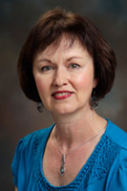
KAREN S. O’CONNOR
Senior Administrative Assistant in Dean's Office (Richards College of Business)
2009-2020
Plans for retirement: looking forward to moving and getting settled in Florida home, traveling, and searching for new hobbies (such as pet sitting, gardening, and kayaking)

Slide 24
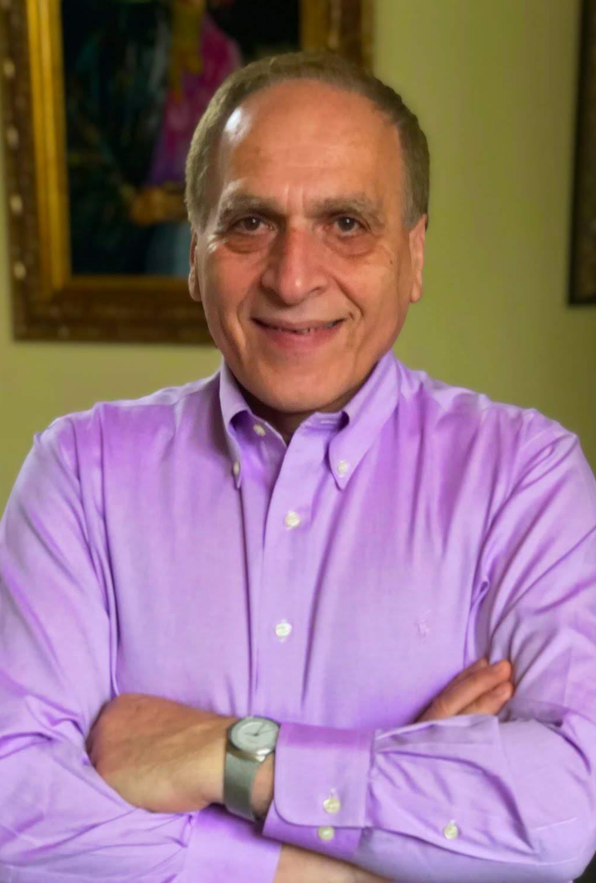
FARAMARZ PARSA
Professor in Management Department (Richards College of Business)
1986-2019
Plans for retirement: traveling in the future; staying active in the field of business

Slide 25
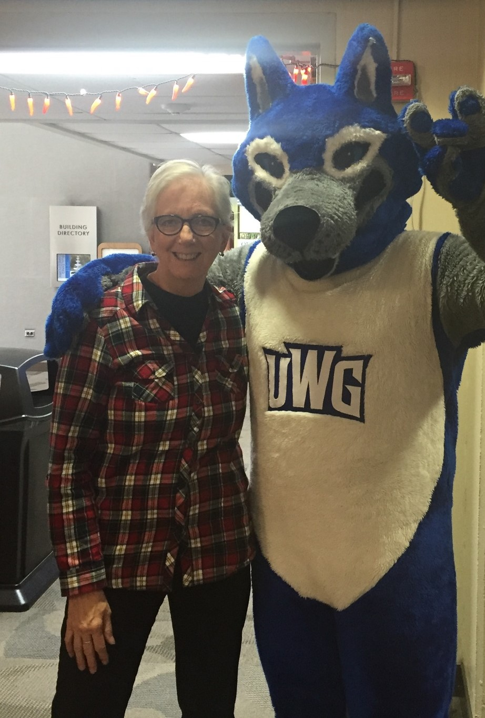
MARY REID
Instructor in Literacy and Special Education and Director of UWG Pre-Kindergarten Program (College of Education)
2016-2020
Plans for retirement: working on a memoir about living in East Africa; traveling, maybe even back to East Africa

Slide 26
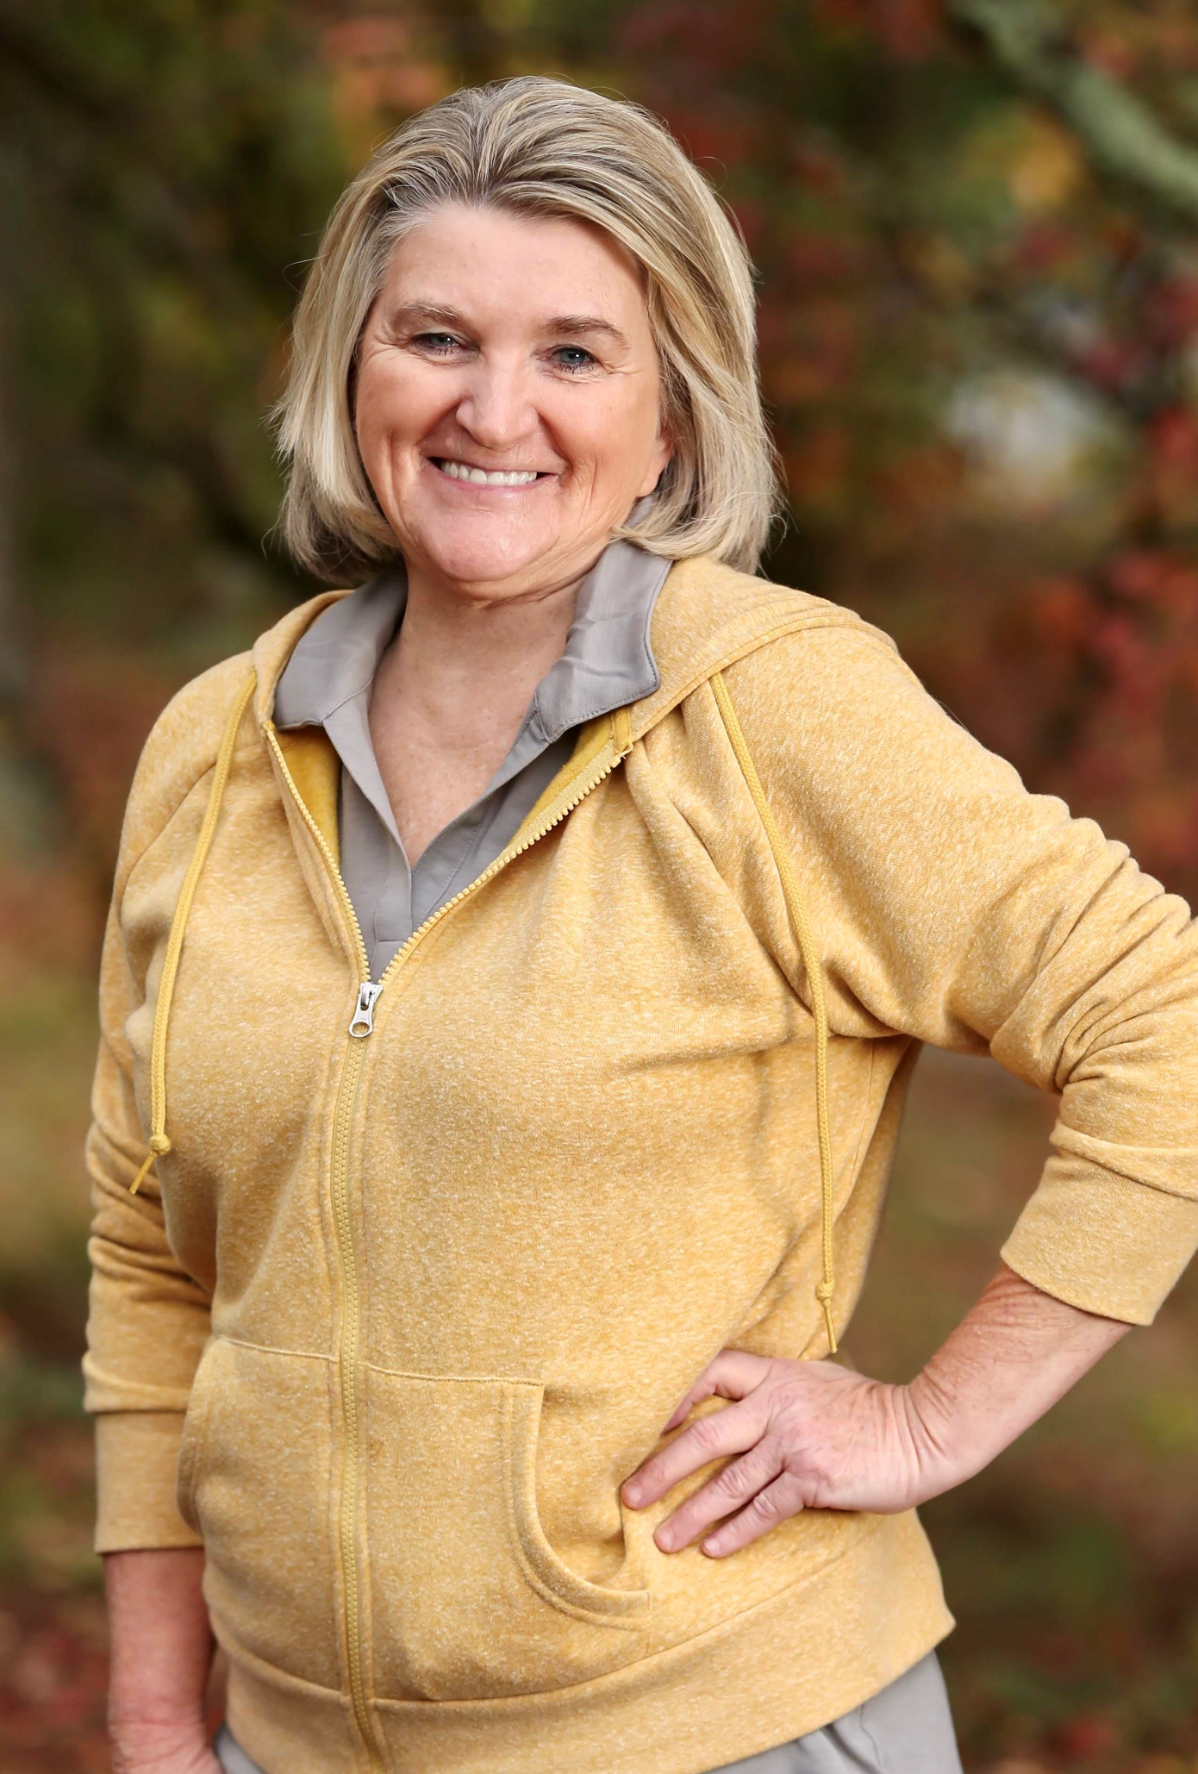
JOHNNIE SAMPLES
Lead Teacher in UWG Pre-Kindergarten Program (College of Education)
1999-2020
Plans for retirement: enjoying family, spending time with grandchildren and great grandchildren, and doing some traveling with her husband

Slide 27
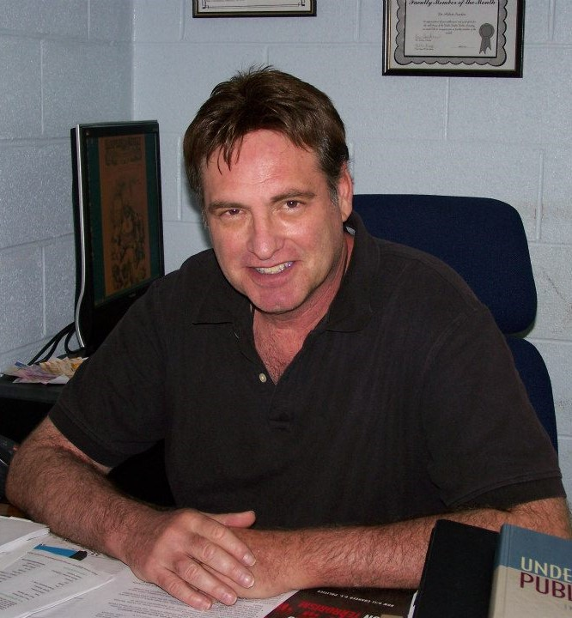
ROBERT M. SANDERS
Professor in Political Science (College of Social Sciences)
1992-2020
Plans for retirement: continue work with Democratic party and Humane Society; eventually moving to Florida; writing (coauthor of a book on presidential impeachment, Politics of Impeachment, which is due out this summer)

Slide 28
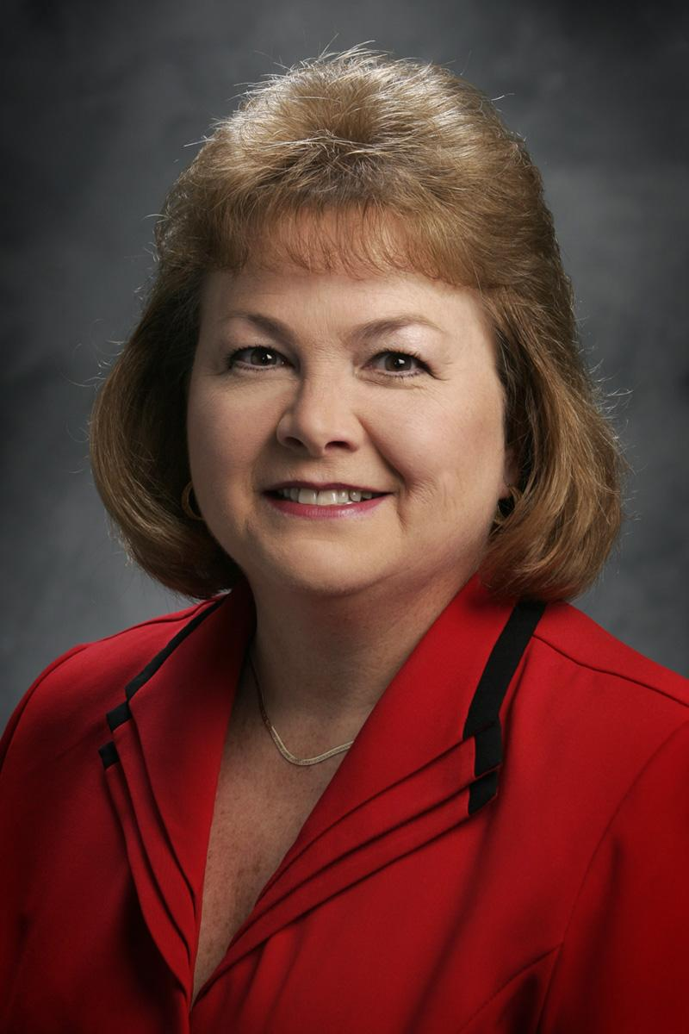
JANE W. SMITH
Office Coordinator in Small Business Center (Richards College of Business)
1999-2019
Plans for retirement: gardening and reading; looking forward to travel adventures with friends

Slide 29
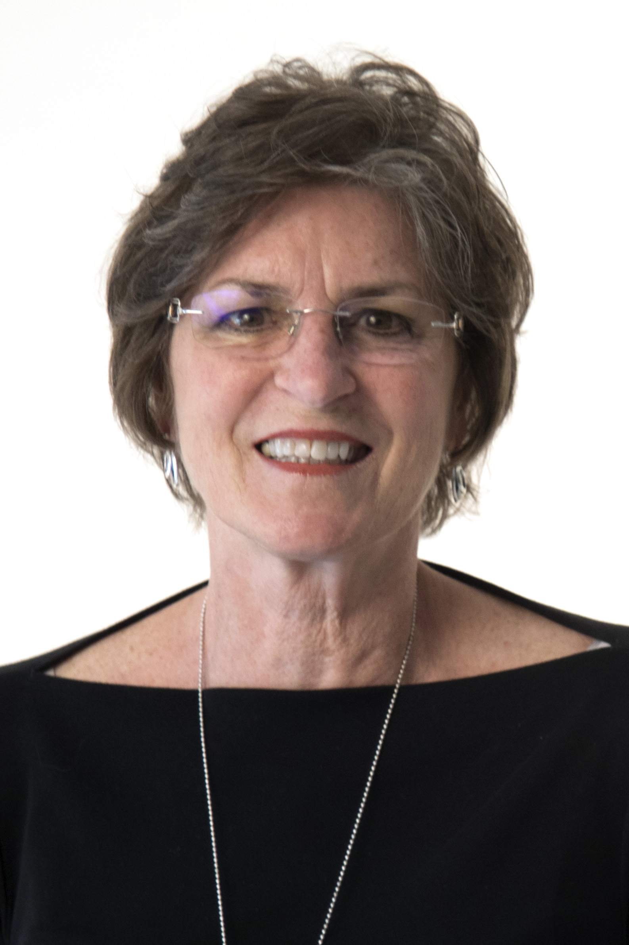
PHYLLIS ROBINSON SNIPES
Professor in School Library Media & Technology Program - Department of Educational Technology and Foundations (College of Education)
1987-2004 (part time); 2005-2019 (full time)
Plans for retirement: working with professional organizations, continuing to work on state-level issues; enjoying family time

Slide 30
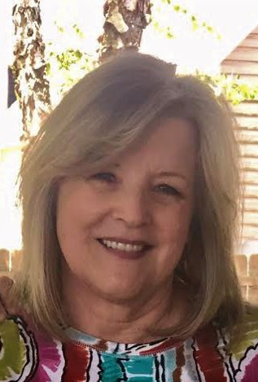
TERESA STEADMAN
Executive Assistant (Student Affairs and Enrollment Management)
2009-2019
Plans for retirement: visiting national parks, bird watching, spending time with grandchildren, being active in the community; "doing whatever I want when I want to do it"

Slide 31
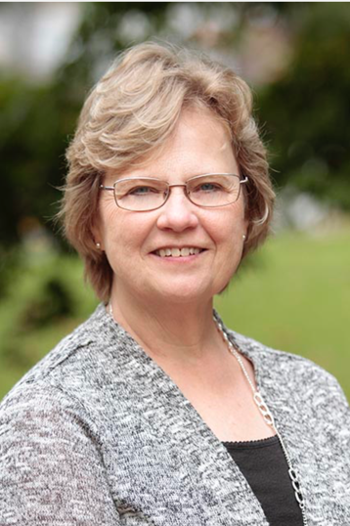
LYNN WEATHERS WILKINSON
Administrative Assistant in the Academic Advisement Center (College of Education)
2009-2019
Plans for retirement: having more opportunity and time to serve God; walking, traveling in the future, reading, and container gardening

Slide 32
HOWARD WILLIAMS
Appliance Programmer in Information Technology Services
2007-2019
Plans for retirement: playing golf, writing music, traveling the world, and gardening

Slide 33
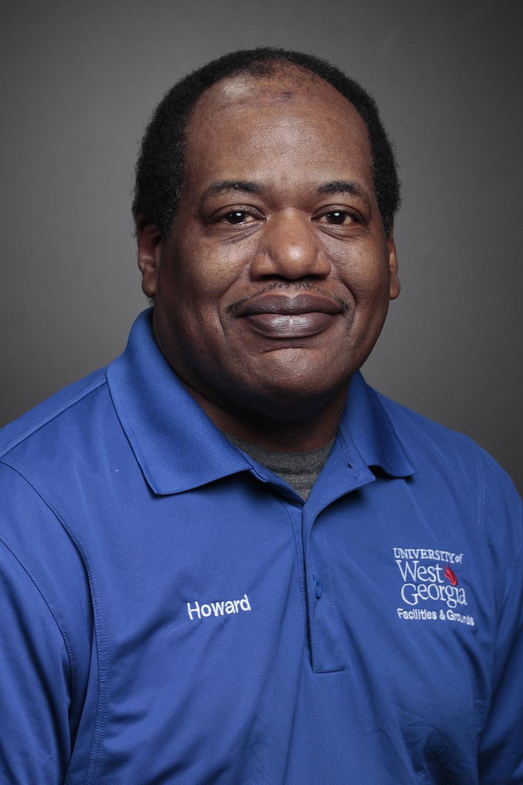
HOWARD WINTERS
Custodial Superintendent in Campus Planning and Facilities (Custodial Services)
1985-2019
Plans for retirement: working around the house, helping take care of parents, traveling, sleeping, and taking it easy

Slide 34
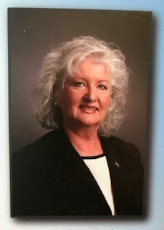
MARY-KATHRYN ZACHARY, J.D.
Professor of Business Administration in Management Department
(Richards College of Business)
1987-2019
Plans for retirement: use cookbooks bought at conferences during her career, international & domestic travel, visit with family & friends, pursue family genealogy/history, develop foreign language & technology skills, write/publish non academic works, help libraries transcribe historical letters, work on health/fitness plans, and read whatever she wants!

Slide 35
Recognition of Service
to the
Association of Retired Faculty & Staff

Slide 36
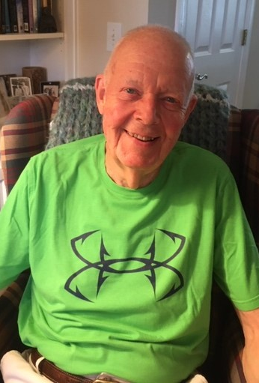
BRUCE LYON

Slide 37
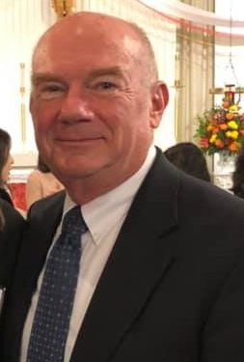
TOM MACKEL

Slide 38
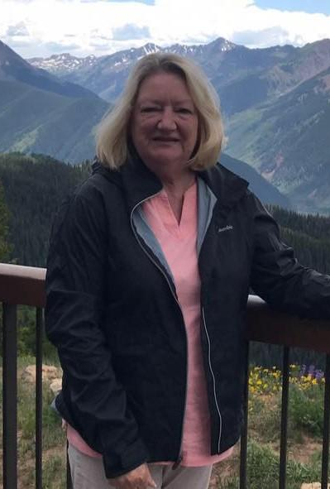
KAREN SMITH

Slide 39
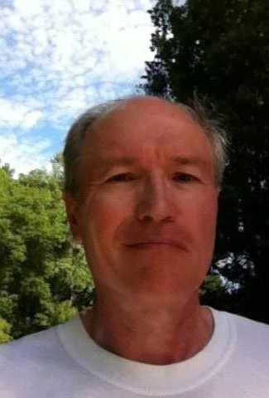
MITCH CLIFTON

Slide 40
CONGRATULATIONS TO OUR RETIREES!

